Slide 1
Capstone Project - The Battle of Neighbourhoods (Finding nearby places for tourist in Mumbai)

Slide 2
INTRODUCTION
Tourism in Mumbai is an industry that attracts almost 6 million tourists per year, making it the 30th-most visited location worldwide. According to United Nations, as of 2018, Mumbai was the second most populous city in India after Delhi and the seventh most populous city in the world with a population of 19.98 million.

Slide 3
As tourists would be interested in exploring places they would need a list of places and an itinerary. In order to make it easier they can use this program to identify all the places of interest in no time and it would be reliable as the places are located nearby. Thus, this program will help to find the underlisted places, nearby:
Restaurants
Parks
Hotels
Cafeteria
Shopping

Slide 4
PROBLEMS
To find the answers to the following questions
List and visualise all major restaurants in Mumbai.
List and visualise all major Parks in Mumbai
List and visualise all major Hotels in Mumbai
List and visualise all major Cafeteria in Mumbai
List and visualise all major Shopping in Mumbai

Slide 5
DATA DESCRIPTION
For this project we need the following data:
Restaurants in Mumbai (India)
Data source: Foursquare API
Description: By using API we will get all restaurants in neighbourhood. We can filter these restaurants to only get nearby restaurants.
Parks in Mumbai (India)
2.1 Data source: Foursquare API
2.2 Description: By using API we will get all hotels in neighbourhood. We can filter these restaurants to only get nearby parks.

Slide 6
Hotels in Mumbai (India)
Data source: Foursquare API
Description: By using API we will get all hotels in neighbourhood. We can filter these restaurants to only get nearby hotels.
Cafeteria in Mumbai (India)
Data source: Foursquare API
Description: By using API we will get all cafeteria in neighbourhood. We can filter these restaurants to only get nearby cafeteria.
Shopping in Mumbai (India)
Data source: Foursquare API
Description: By using API we will get all shopping in neighbourhood. We can filter these restaurants to only get nearby shopping

Slide 7
METHODOLOGY
We begin by searching the city, its longitude and latitude.
Then searching the hotels form the searched city, using Foursquare API.
Then cleaning the hotels dataframe i.e. by deleting unnecessary columns, deleting rows with none values, deleting rows which its category is not Hotel, deleting rows which has duplicate hotel’s name.
Now we search the nearby parks.
Cleaning the parks dataframe.
Now we search the nearby restaurants.
Cleaning the restaurants dataframe.

Slide 8
Now collecting the dataframe nearby cafeteria
Cleaning the cafeteria dataframe.
At last collecting the nearby shopping centers
Cleaning the shopping dataframe

Slide 9
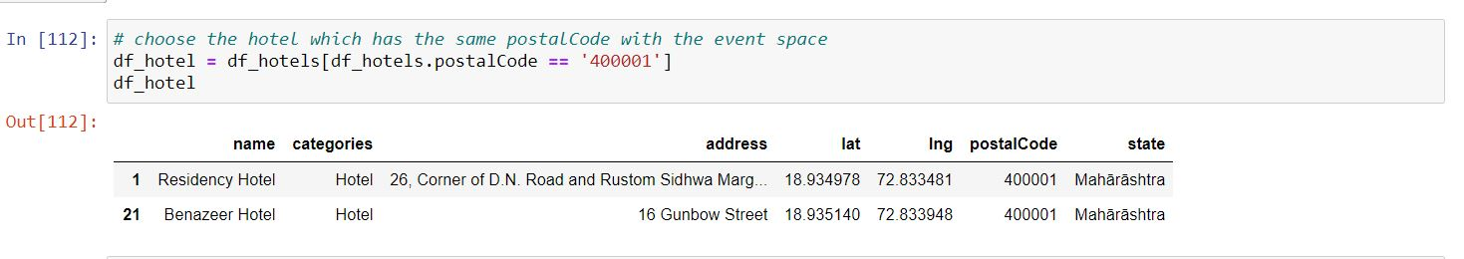
RESULT
The nearest hotel are:

Slide 10
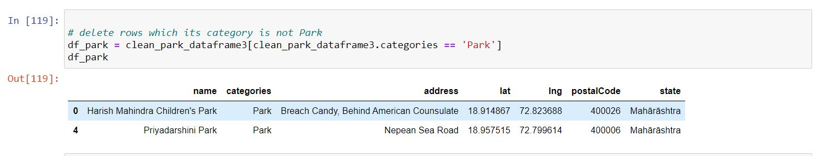
The nearest parks are:

Slide 11
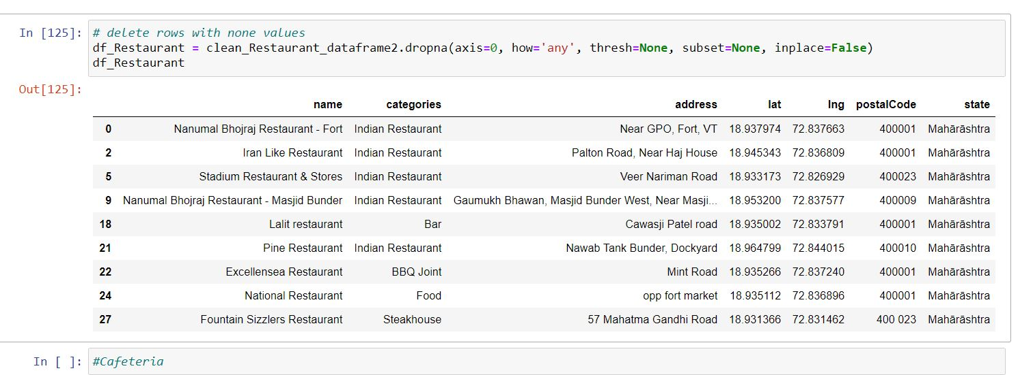
The nearby restaurants are:

Slide 12
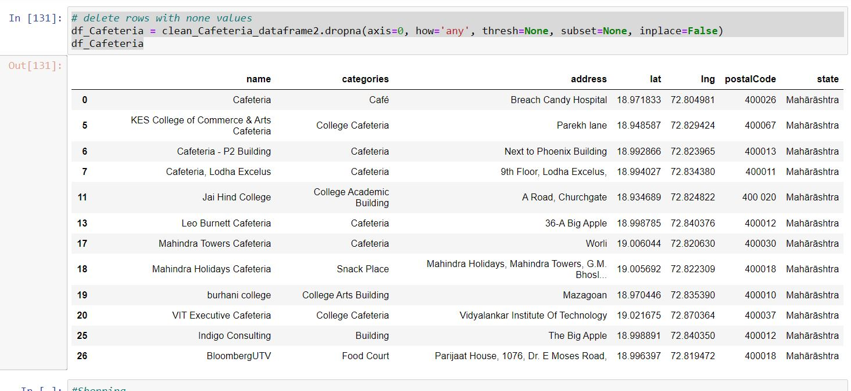
The nearby cafeteria are:

Slide 13
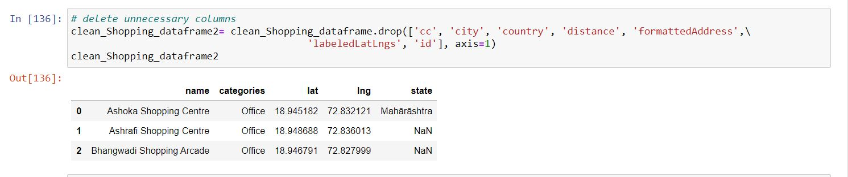
The nearby shopping place are:

Slide 14
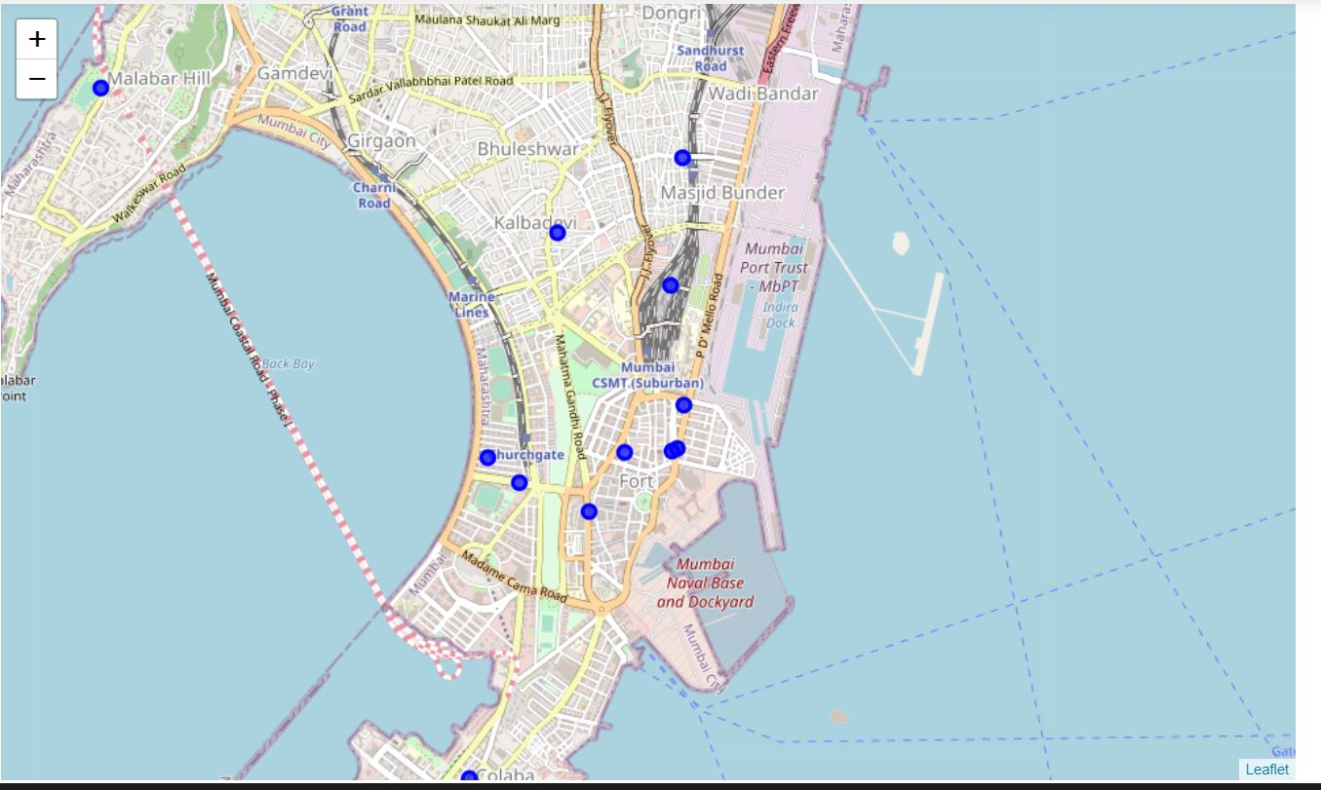
DATA VISUALIZATION
Visualization of neighborhood including Restaurant and Cafeteria

Slide 15
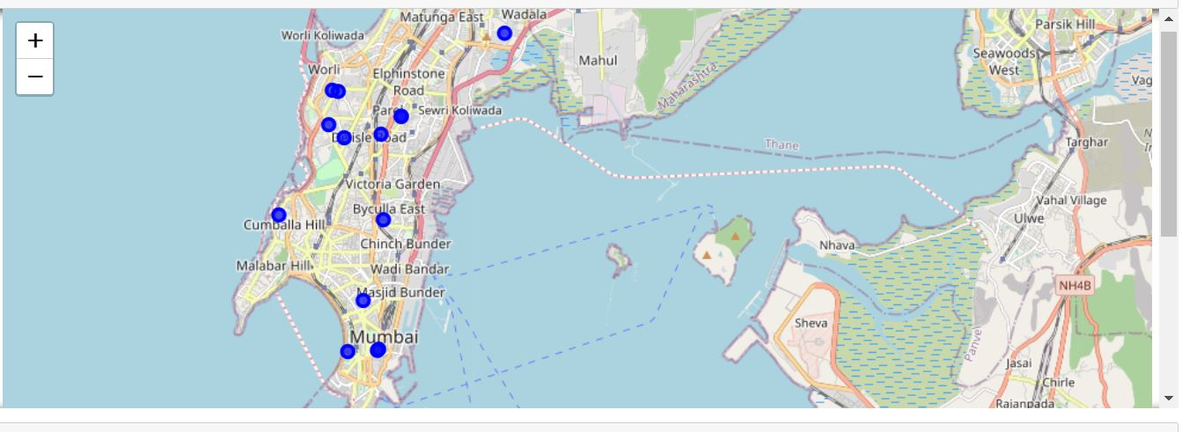
Map to visualize hotel neighborhood including shopping stores and Cafeteria

Slide 16
THANK YOU

